Slide 1
Unit I [Heaps (Priority Queues) ]

Slide 2
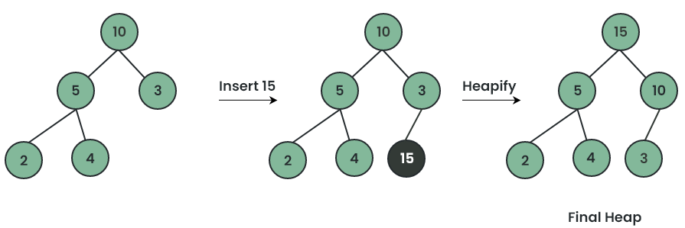
HEAP : Insertion
A Max-Heap is defined as a type of Heap Data Structure in which each internal node is greater than or equal to its children.

Slide 3
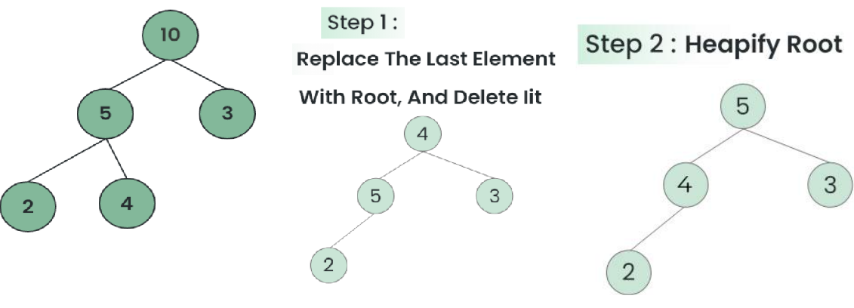
Deletion
time complexity : O(log n).

Slide 4
Array representation of binary heap

Slide 5
Creation of heap tree concept
Write a program to create the following:
1. Max Heap
2. Min Heap
[Implement it by taking the digits of your registration number and DOB, ignore the repetition for practice]

Slide 6
Heap sort
Heap sort is a comparison-based sorting algorithm that utilizes a binary heap data structure to sort elements.
The heap sort algorithm can be broken down into two main phases: building a max heap from the unsorted array and then repeatedly removing the largest element (the root of the heap) and adjusting the heap accordingly.
Time Complexity: O(N log N)
Auxiliary Space: O(log n), due to the recursive call stack.
However, auxiliary space can be O(1) for iterative implementation.

Slide 7
Task
Write a program for heap sort.
Find the K’th Largest element in array (simple and heap method)

Slide 8
Sort a nearly sorted (or K sorted) array
1 Insertion Sort
Insertion sort is particularly effective for nearly sorted arrays. Since each element is only a few positions away from its correct place, the algorithm can sort the array in ( O(N * k) ) time, where
( N ) is the number of elements and
( k ) is the maximum distance any element is from its correct position.
2 Min-Heap
Using a min-heap can further optimize the sorting process to
( O(N * log k) ).
This method involves maintaining a heap of size
( k+1 ) to keep track of the smallest elements.

Slide 9
Task
Given an array of N elements, where each element is at most K away from its target position, devise an algorithm that sorts in less than O(N^2) time

Slide 10
Connect n ropes with minimum cost
You have been given 'N' ropes of different lengths, we need to connect these ropes into one rope.
The cost to connect two ropes is equal to sum of their lengths. We need to connect the ropes with minimum cost.
ROPES: 4, 3, 2, 6
Explanation:
1) connect ropes of lengths 2 and 3 ➔ 4 ,5, 6 [Cost:5]
2) Now connect ropes of lengths 4 and 5➔ 9, 6 [Cost:5+9]
3) Finally, we connect the remaining two ropes ➔ 15 [Cost:5+9+15] = 29
[Optimum Solution]
Practice: https://www.geeksforgeeks.org/problems/minimum-cost-of-ropes-1587115620/1

Slide 11
Connect n ropes with minimum cost contd…
Naive Approach
Sort all the elements in ascending order
Take two ropes of minimum lengths and combine them
Delete the two minimal lengths taken above and insert a new length(sum of lengths)
Repeat the above steps till the elements left in the array is less than 2.
Best Time Complexity for sorting = n log n
So, for n iterations, it would take = n²log n
ROPES: 4, 3, 2, 6
Sort: 2,3,4,6 O(n)
2+3= 5 5
Ropes: 5,4,6
Sort: 4,5,6 O(n)
4+5=9 14
Ropes: 9,6
Sort: 6,9 O(n)
6+9=15 29
15

Slide 12
contd…
Optimized Approach
Create a min Heap
At any time, take two ropes of minimum lengths and combine them.
Pop the two minimal lengths taken above and insert a new length(sum of lengths) into the min-heap.
Find the most optimal Cost.
The time complexity for this problem will reduce from O (n²*log n) to O (n*log n).
ROPES: 4, 3, 2, 6
Min heap: 2,3,4,6
Pop:2,3
2+3= 5 5
Insert: 5 log()
4,6,5
Pop:4,5
4+5=9 14
Insert:9 log()
6,9
Pop:6,9
6+9=15 29
Insert: 15 log()

Slide 13
Link to practise problem related to the topic
https://leetcode.com/tag/heap-priority-queue/

Slide 14
Unit II [Disjoint Set Union]

Slide 15
2. Union-Find algorithm
The Union-Find algorithm, also known as the Disjoint Set Union (DSU) or the Disjoint Set Data Structure, is a data structure that keeps track of a partition of a set into disjoint (non-overlapping) subsets. It supports two primary operations efficiently:
Find: Determine the representative or "leader" of the subset a particular element belongs to. This operation helps in checking if two elements are in the same subset.
Union: Merge two subsets into a single subset.

Slide 16
Operations on Disjoint Set Data Structures:
1. Find: Can be implemented by recursively traversing the parent array until we hit a node that is the parent of itself.
Time complexity: This approach is inefficient and can take O(n) time in worst case.
2. Union: It takes two elements as input and finds the representatives of their sets using the Find operation, and finally puts either one of the trees (representing the set) under the root node of the other tree.
Time complexity: This approach is inefficient and could lead to tree of length O(n) in worst case.
Optimizations (Union by Rank/Size and Path Compression):
First is Union by Rank, which considers height of the tree as the factor and
Second is Union by Size, which considers size of the tree as the factor while attaching one tree to the other .

Slide 17
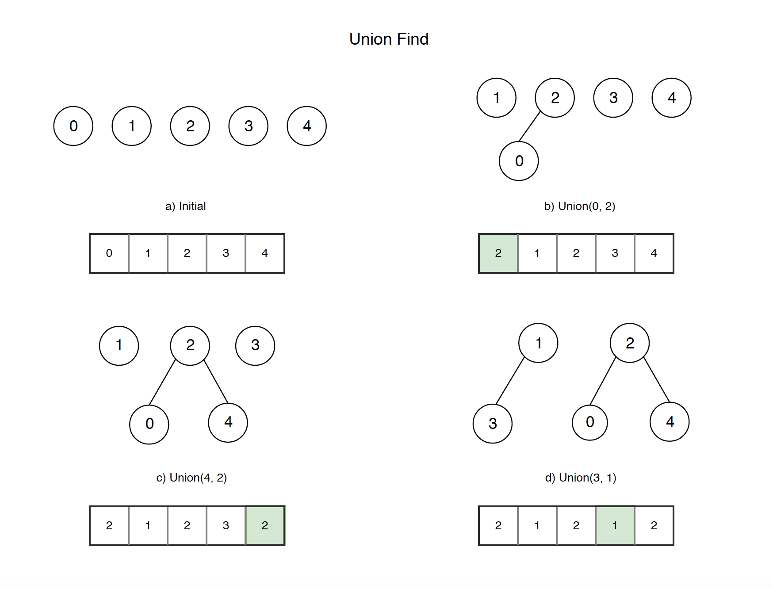
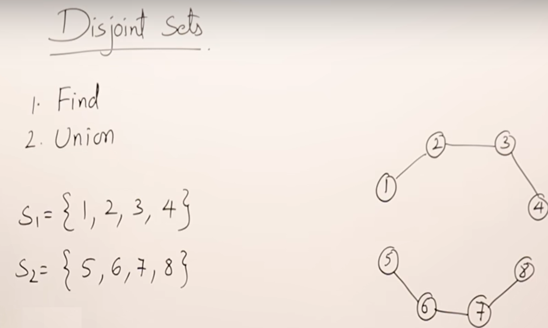

Slide 18
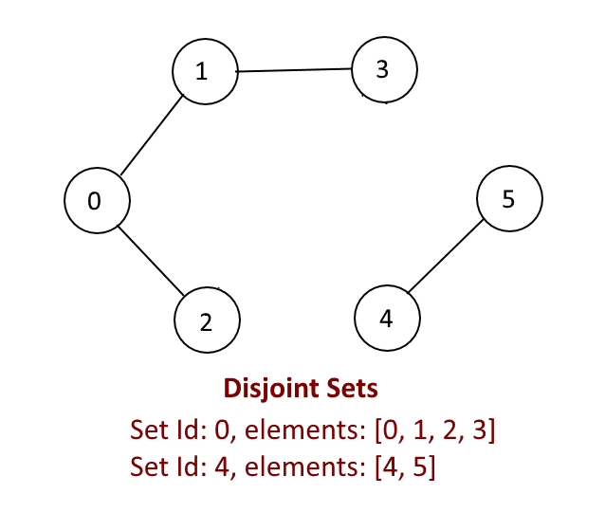

Slide 19
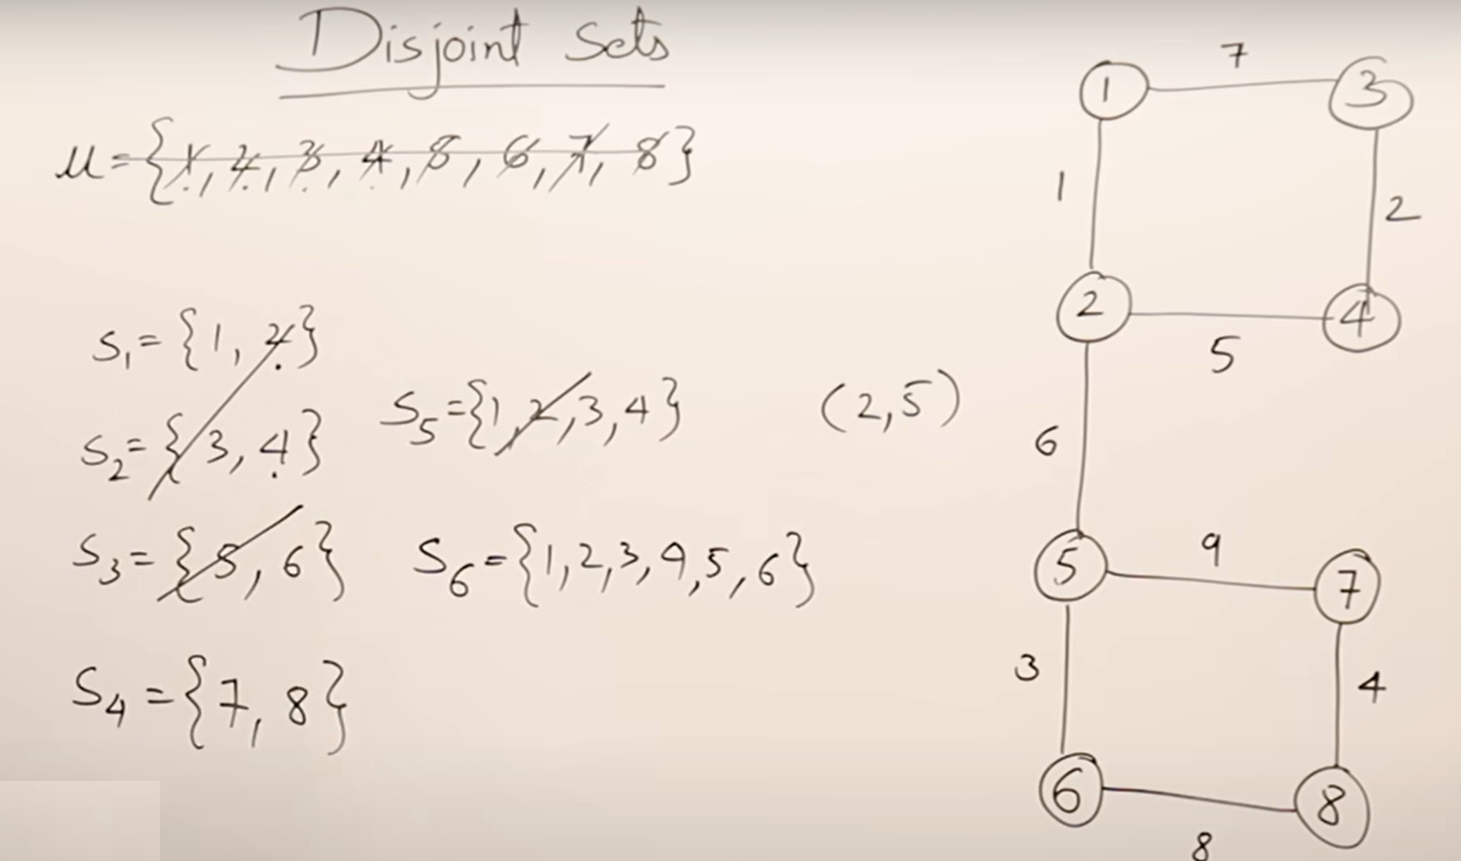

Slide 20
Similar to the Kruskal’s Algo
While not considering the weights.
So it will act as spanning tree (but not necessary the min. one)

Slide 21
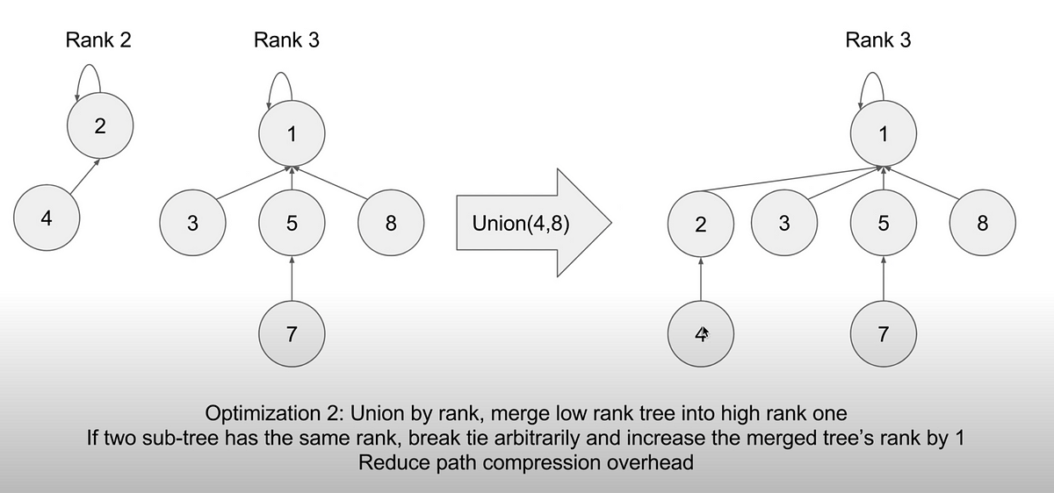
2.1 Union by Rank
Union by Rank is an optimization technique used to keep the tree flat.
The idea is to always attach the smaller tree under the root of the larger tree.
This helps in keeping the tree shallow, which in turn helps in keeping the operations efficient.
Rank: It is a measure of the depth of the tree.
When performing a union operation, the root of the tree with the smaller rank is made a child of the root of the tree with the larger rank.

Slide 22
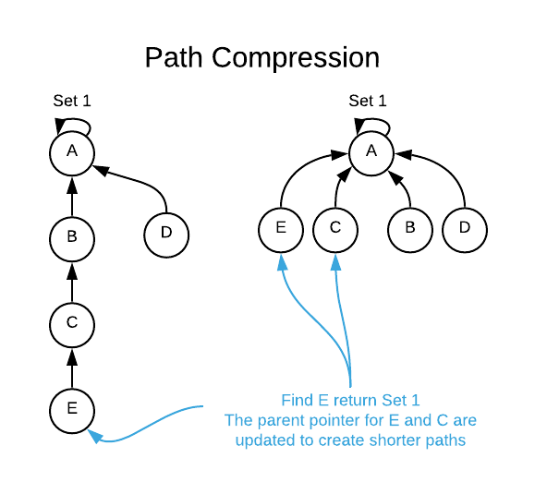
2.3 Path Compression
Path Compression is another optimization technique used during the Find operation.
The idea is to make the tree flat by making every node point directly to the root whenever Find is called.
This drastically reduces the time complexity of future operations.
When a Find operation is performed, it traverses up the tree and makes every node on the path point directly to the root.
This flattens the structure of the tree, leading to very efficient subsequent operations.

Slide 23
Applications
Kruskal’s Minimum Spanning Tree Algorithm: Used to check if adding an edge would form a cycle.
Connected Components: Finding and merging connected components in a graph.
Image Processing: Labeling connected components in binary images.
Network Connectivity: Managing connectivity in dynamic networks.

Slide 24
Resource and Practice/Task
Resource
https://www.youtube.com/watch?v=3gbO7FDYNFQ
https://www.geeksforgeeks.org/introduction-to-disjoint-set-data-structure-or-union-find-algorithm/
Task
https://www.geeksforgeeks.org/problems/union-find/1

Slide 25
[Reading]
https://www.hackerearth.com/practice/notes/disjoint-set-union-union-find/
[Video]
https://www.youtube.com/watch?v=ayW5B2W9hfo
[Practice]
https://www.geeksforgeeks.org/problems/disjoint-set-union-find/0

Slide 26
Unit III [Binary trees]

Slide 27
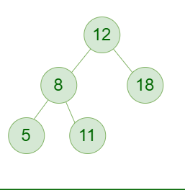
Types of Binary Tree
1. Full Binary Tree: A Binary Tree is a full binary tree if every node has 0 or 2 children. The following are examples of a full binary tree. We can also say a full binary tree is a binary tree in which all nodes except leaf nodes have two children.
A full Binary tree is a special type of binary tree in which every parent node/internal node has either two or no children. It is also known as a proper binary tree.
https://www.geeksforgeeks.org/types-of-binary-tree/

Slide 28
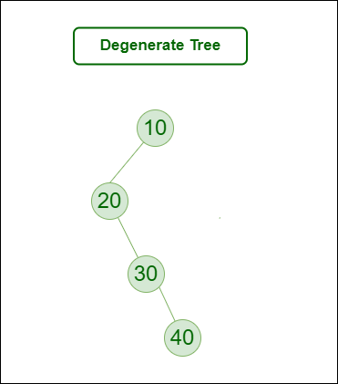
Degenerate (or pathological) tree
A Tree where every internal node has one child.
Such trees are performance-wise same as linked list.
A degenerate or pathological tree is a tree having a single child either left or right.

Slide 29
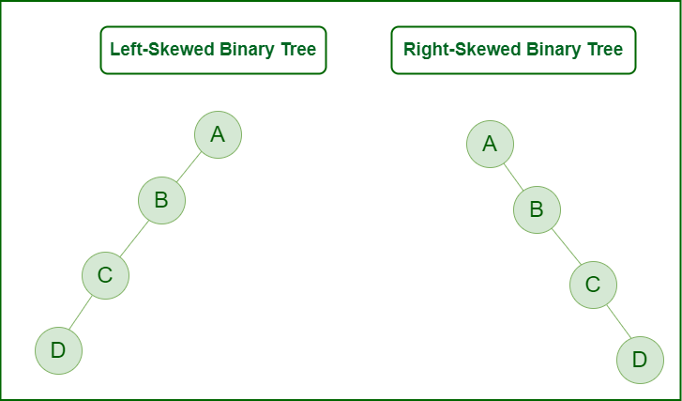
Skewed Binary Tree
A skewed binary tree is a pathological/degenerate tree in which the tree is either dominated by the left nodes or the right nodes.
Thus, there are two types of skewed binary tree: left-skewed binary tree and right-skewed binary tree.

Slide 30
Complete Binary Tree
A Binary Tree is a Complete Binary Tree if all the levels are completely filled except possibly the last level and the last level has all keys as left as possible.
A complete binary tree is just like a full binary tree, but with two major differences:
Every level except the last level must be completely filled.
All the leaf elements must lean towards the left.
The last leaf element might not have a right sibling i.e. a complete binary tree doesn’t have to be a full binary tree.

Slide 31
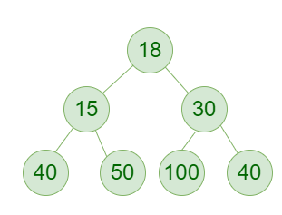
Perfect Binary Tree
A Binary tree is a Perfect Binary Tree in which all the internal nodes have two children and all leaf nodes are at the same level.
The following are examples of Perfect Binary Trees.
A perfect binary tree is a type of binary tree in which every internal node has exactly two child nodes and all the leaf nodes are at the same level.

Slide 32
Balanced Binary Tree
A binary tree is balanced if the height of the tree is O(Log n) where n is the number of nodes.
For Example, the AVL tree maintains O(Log n) height by making sure that the difference between the heights of the left and right subtrees is at most 1.
Red-Black trees maintain O(Log n) height by making sure that the number of Black nodes on every root to leaf paths is the same and that there are no adjacent red nodes.
Balanced Binary Search trees are performance-wise good as they provide O(log n) time for search, insert and delete.

Slide 33
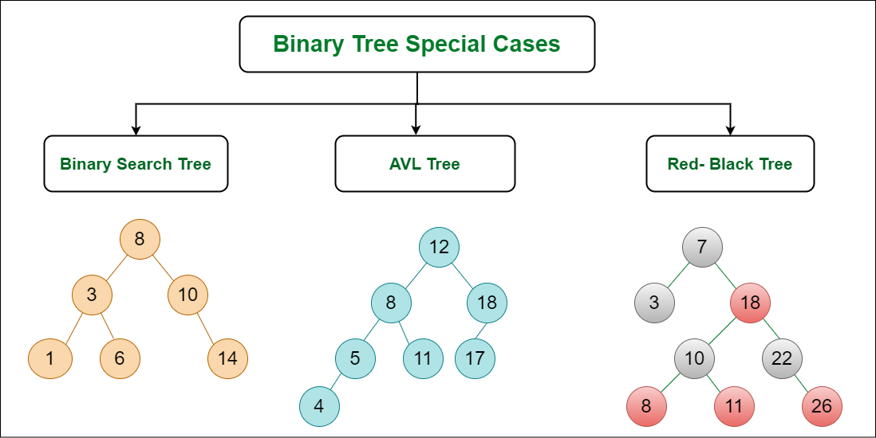
Some Special Types of Trees:
Binary Search Tree
AVL Tree
Red Black Tree
B Tree
B+ Tree
Segment Tree

Slide 34
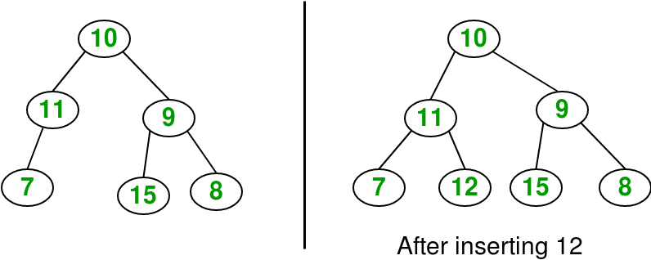
Insertion in a tree
Given a binary tree and a key, insert the key into the binary tree at the first position available in level order.
The idea is to do an iterative level order traversal of the given tree using queue.
If we find a node whose left child is empty, we make a new key as the left child of the node.
Else if we find a node whose right child is empty, we make the new key as the right child.
We keep traversing the tree until we find a node whose either left or right child is empty
https://www.geeksforgeeks.org/insertion-in-a-binary-tree-in-level-order/

Slide 35
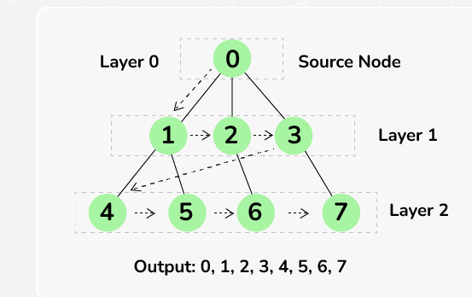
Level Order Traversal (Breadth First Search or BFS) of Binary Tree
Level Order Traversal technique is defined as a method to traverse a Tree such that all nodes present in the same level are traversed completely before traversing the next level.

Slide 36
Deletion in a Binary Tree
Given a binary tree, delete a node from it by making sure that the tree shrinks from the bottom (i.e. the deleted node is replaced by the bottom-most and rightmost node).
This is different from BST deletion. Here we do not have any order among elements, so we replace them with the last element.
Algorithm:
Starting at the root, find the deepest and rightmost node in the binary tree and the node which we want to delete.
Replace the deepest rightmost node’s data with the node to be deleted.
Then delete the deepest rightmost node.

Slide 37
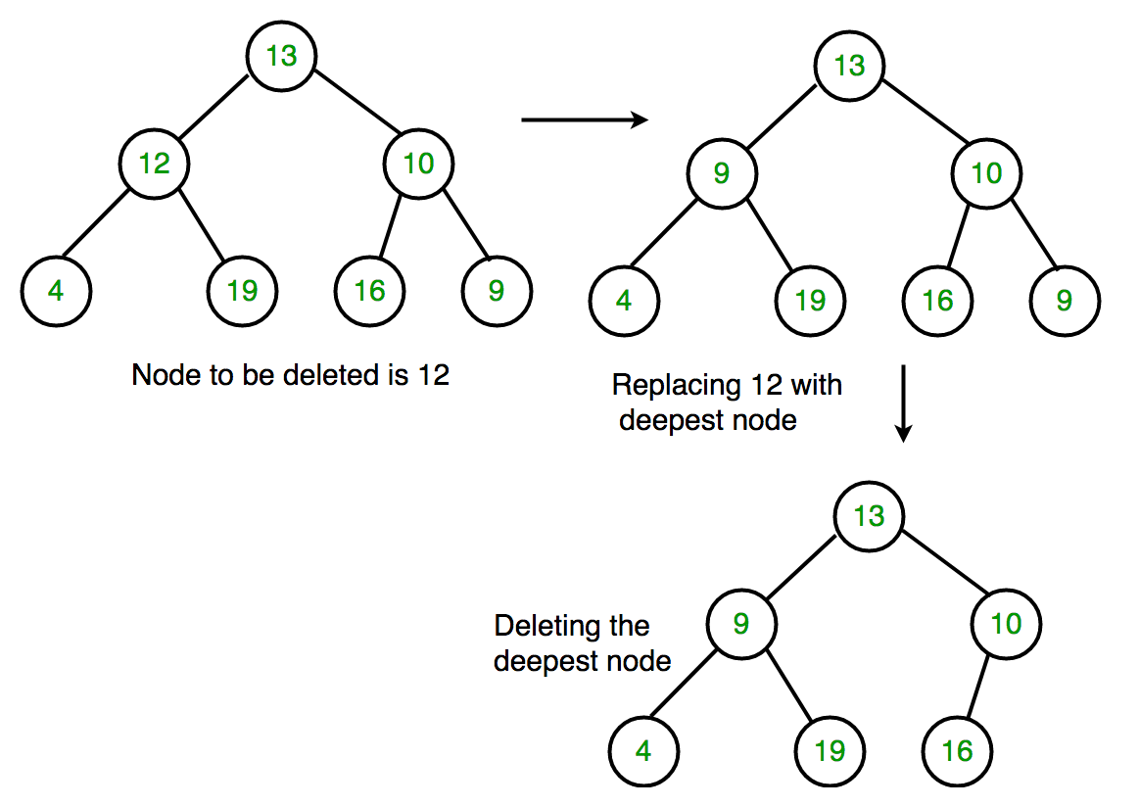

Slide 38
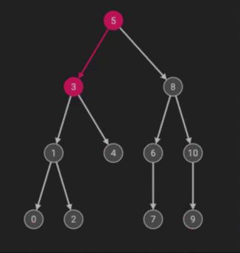
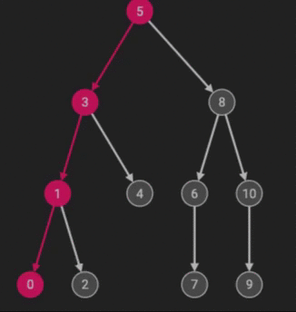
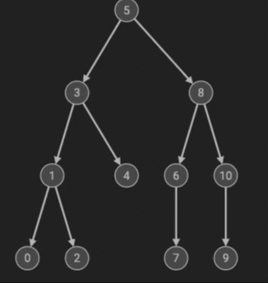
Tree traversals [Task]
Inorder Postorder Preorder

Slide 39
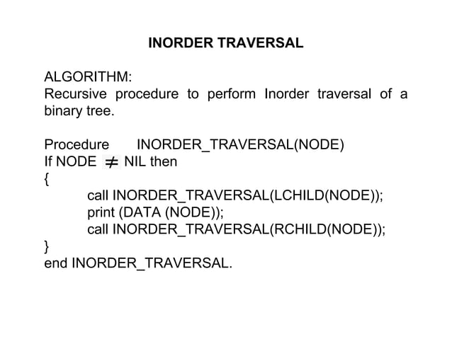

Slide 40
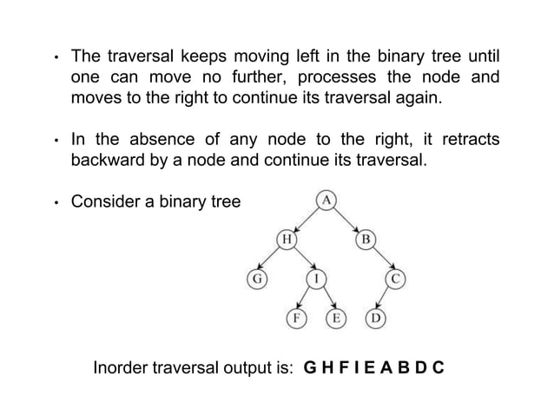

Slide 41
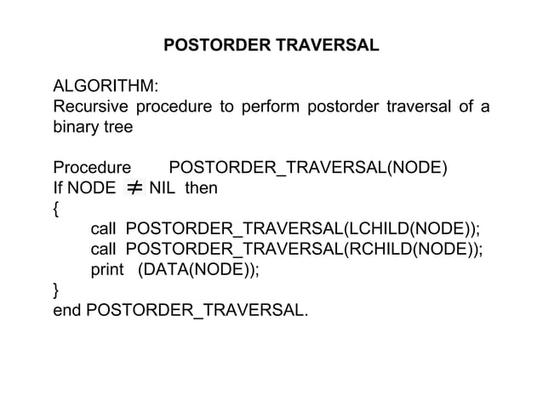

Slide 42
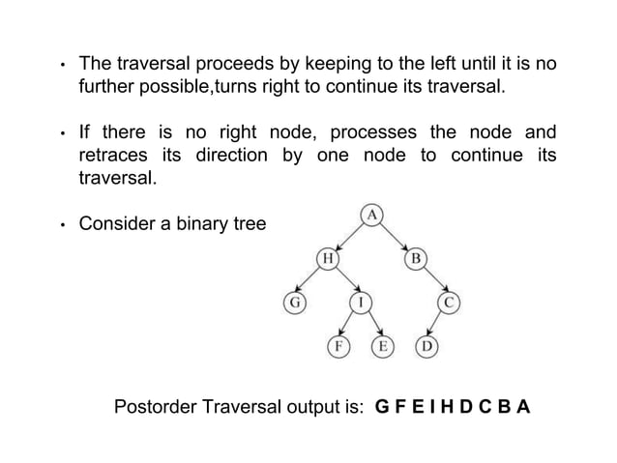

Slide 43
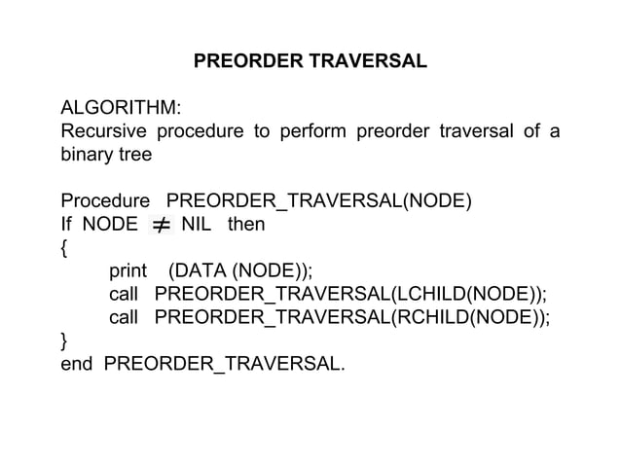

Slide 44
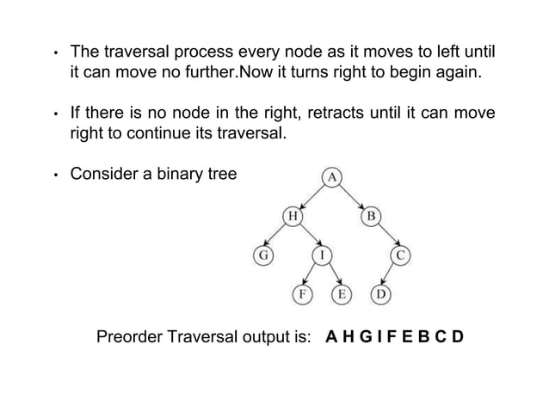

Slide 45
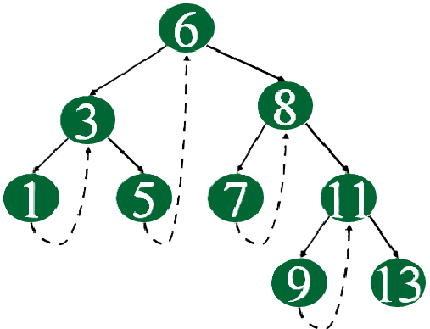
Inorder traversal without recursion
Using Morris Traversal, we can traverse the tree without using stack and recursion. The idea of Morris Traversal is based on Threaded Binary Tree.
In this traversal, we first create links to Inorder successor and print the data using these links, and finally revert the changes to restore original tree.

Slide 46
Create an empty stack (say S).
Initialize the current node as root.
Push the current node to S and set current = current->left until current is NULL
If current is NULL and the stack is not empty then:
Pop the top item from the stack.
Print the popped item and set current = popped_item->right
Go to step 3.
If current is NULL and the stack is empty then we are done.

Slide 47
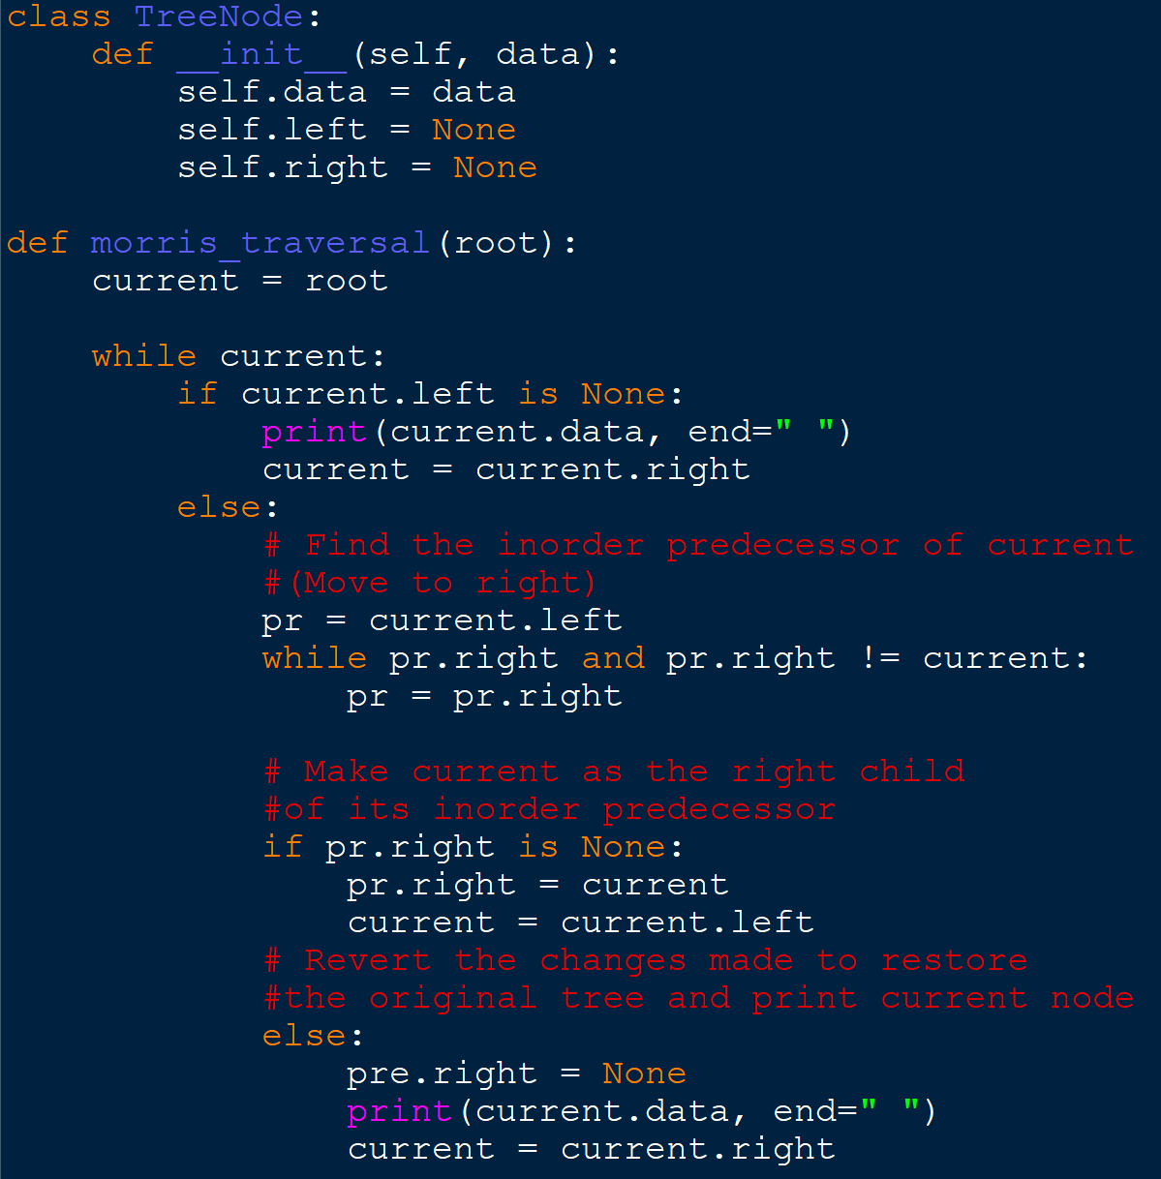
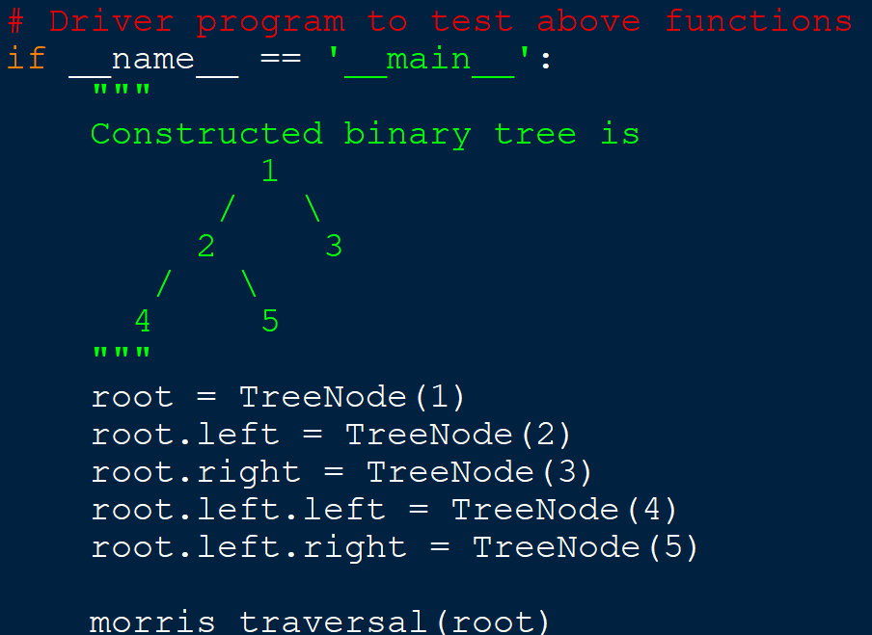

Slide 48
Print Postorder traversal from given Inorder and Preorder traversals
Input:
Inorder traversal in[] = {4, 2, 5, 1, 3, 6}
Preorder traversal pre[] = {1, 2, 4, 5, 3, 6}
Output:
Postorder traversal is {4, 5, 2, 6, 3, 1}

Slide 49
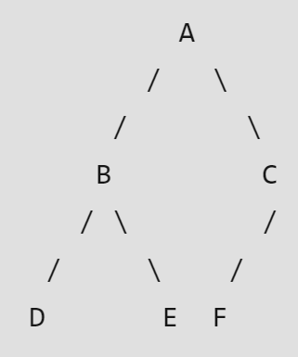
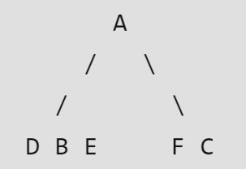
Let us consider the below traversals:
Inorder sequence: D B E A F C
Preorder sequence: A B D E C F

Slide 50
Resource: https://www.geeksforgeeks.org/preorder-from-inorder-and-postorder-traversals/
https://www.geeksforgeeks.org/construct-tree-from-given-inorder-and-preorder-traversal/
Practice: https://www.geeksforgeeks.org/problems/postorder-traversal/1?itm_source=geeksforgeeks&itm_medium=article&itm_campaign=practice_card

Slide 51
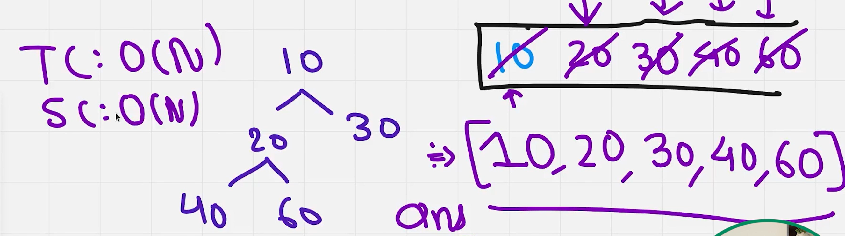
Level Order Tree Traversal
Level Order Traversal technique is defined as a method to traverse a Tree such that all nodes present in the same level are traversed completely before traversing the next level.
https://www.geeksforgeeks.org/level-order-tree-traversal/ [video explanation]

Slide 52
Unit IV [Problems based on Binary Trees]

Slide 53
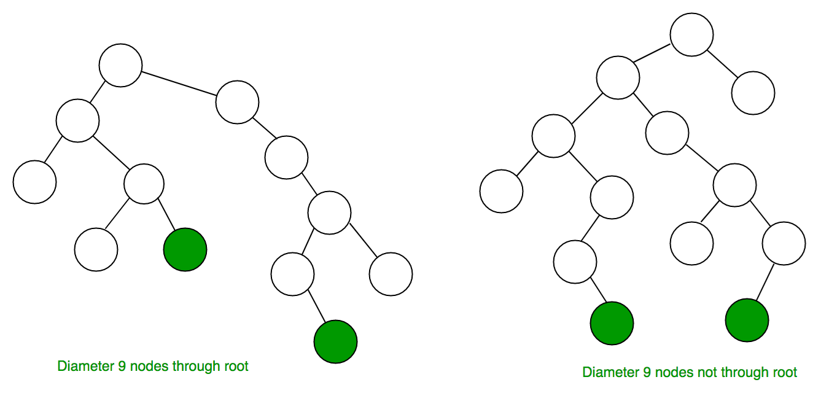
4.1 Diameter of a tree
The diameter/width of a tree is defined as the number of nodes on the longest path between any two nodes.
https://www.geeksforgeeks.org/diameter-of-a-binary-tree/

Slide 54
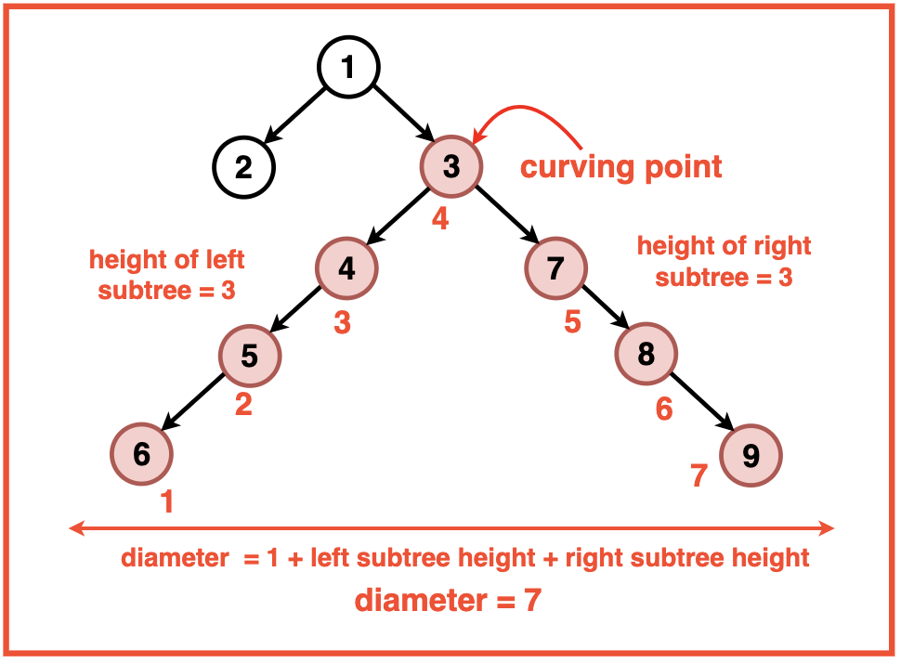
To find the diameter of a binary tree, we can think of every node as a potential `Curving Point` of the diameter path. This Curving Point is the node along the diameter path that holds the maximum height and from where the path curves uphill and downhill.

Slide 55
we can see that the diameter at a specific curving point is determined by adding the height of the left subtree to the height of the right subtree and adding 1 to account for the level of the curving point.
Diameter = 1 + Left Subtree Height + Right Subtree Height
Therefore, we can traverse the tree recursively considering each node as a potential Curving Point and calculate the height of the left and right subtrees at each node.
This will give us the diameter for the current Curving Point.
Throughout the traversal, we track the maximum diameter encountered and return it as the overall diameter of the Binary Tree.

Slide 56
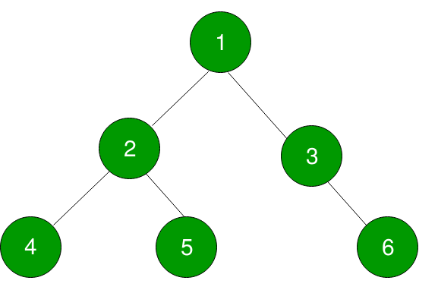
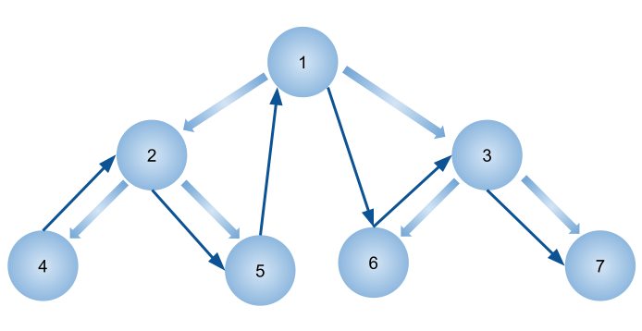
4.2 Populate Inorder Successor for all nodes
Inorder Successor of a node in binary tree is the next node in Inorder traversal of the Binary Tree.
Inorder Successor is NULL for
the last node in Inorder traversal.
Inorder successor of node 4 is 2 and
node 5 is 1.
Inorder: 4,2,5,1,3,6
Refefrence material: https://www.geeksforgeeks.org/populate-inorder-successor-for-all-nodes/

Slide 57
https://www.geeksforgeeks.org/inorder-succesor-node-binary-tree/
Iterative implementation using parent pointer
We need to take care of 3 cases for any node to find its inorder successor as described below:
Case 0.If the node is the rightmost node in the given tree. For example, in the above tree node 6 is the right most node. In this case, there will be no inorder successor of this node. i.e. Inorder Successor of the rightmost node in a tree is NULL.
Case 1: If the right child of the node is not NULL then the inorder successor of this node will be the leftmost node in it’s right subtree.
Example in the above given tree, inorder successor of node 2 will be 5.
Case 2: If the right child of node is NULL. Then we keep finding the parent of the given node x, say p such that p->left = x.
Example in the above given tree, inorder successor of node 5 will be 1. First parent of 5 is 2 but 2->left != 5. So next parent of 2 is 1, now 1->left = 2. Therefore, inorder successor of 5 is 1.

Slide 58
4.3 Find n-th node of inorder traversal
We do simple Inorder Traversal.
While doing the traversal, we keep track of the count of nodes visited so far.
When the count becomes n, we print the node.
https://www.geeksforgeeks.org/find-n-th-node-inorder-traversal/

Slide 59
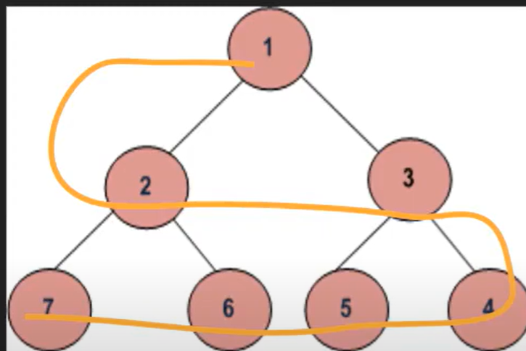
4.4 Level Order traversal in spiral form

Slide 60
We need to print every alternate level in the reverse order i.e.i.e. from right to left. To implement this we can keep a boolean variable (say ltr).
The number of levels in the tree is equal to its height.
We will use a loop to iterate over all the levels and print them as per the value of ltr.
Consider the root node of the tree.
boolean ltr <- true.
h <- height of the given tree
For i = 1 to h do:
Print Level which prints the node at the ith level as per the value of ltr.
ltr = !ltr

Slide 61
Explanation:
https://www.geeksforgeeks.org/level-order-traversal-in-spiral-form/
https://www.youtube.com/watch?v=mUGFMHBvA50
Task
https://www.geeksforgeeks.org/problems/level-order-traversal-in-spiral-form/1

Slide 62
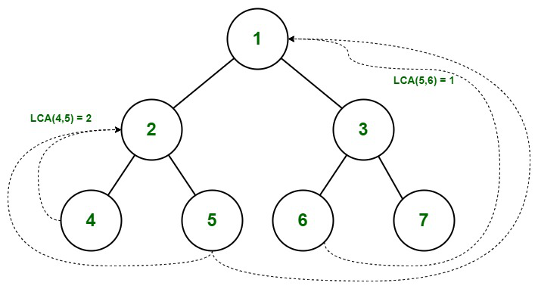
Finding Lowest Common Ancestors [LCA]
The lowest common ancestor is the lowest node in the tree that has both n1 and n2 as descendants, where n1 and n2 are the nodes for which we wish to find the LCA.
Hence, the LCA of a binary tree with nodes n1 and n2 is the shared ancestor of n1 and n2 that is located farthest from the root.

Slide 63
The steps to Follow:
Find a path from the root to n1 and store it in a vector or array.
Find a path from the root to n2 and store it in another vector or array.
Traverse both paths till the values in arrays are the same. Return the common element just before the mismatch.

Slide 64
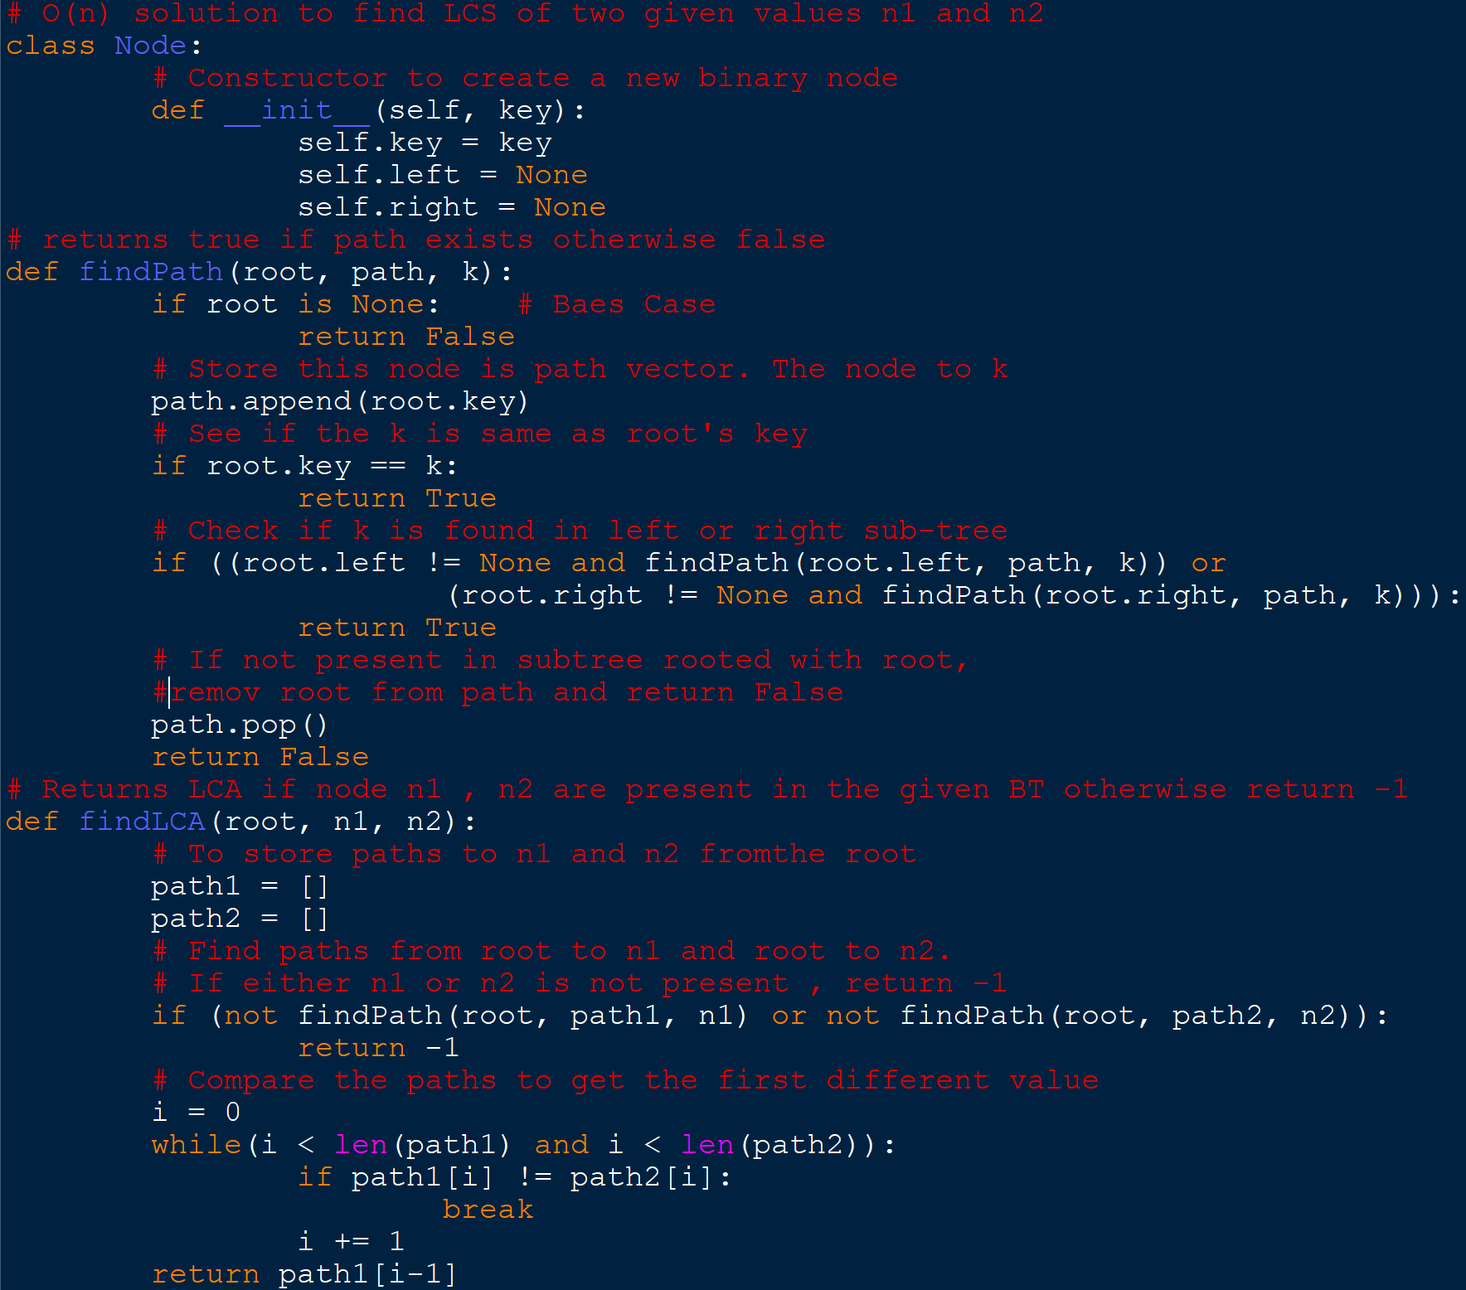
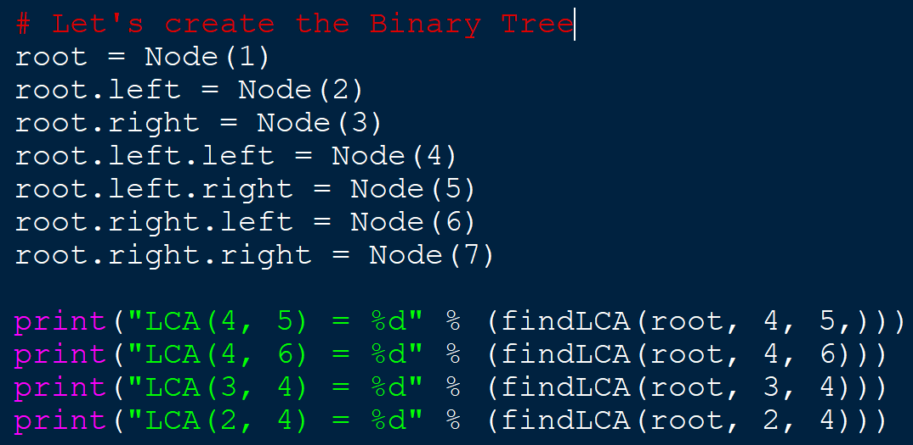
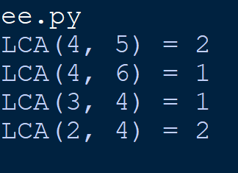
Practice Problem: https://leetcode.com/problems/lowest-common-ancestor-of-a-binary-tree/description/

Slide 65
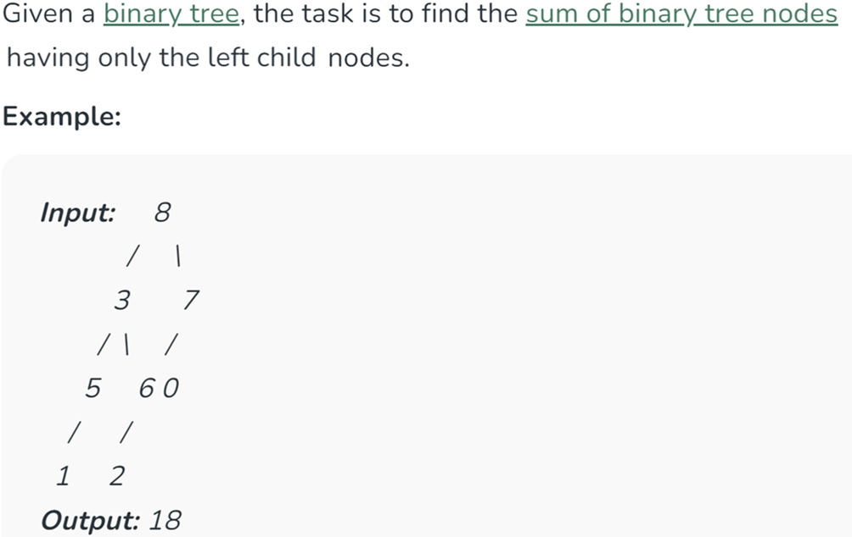
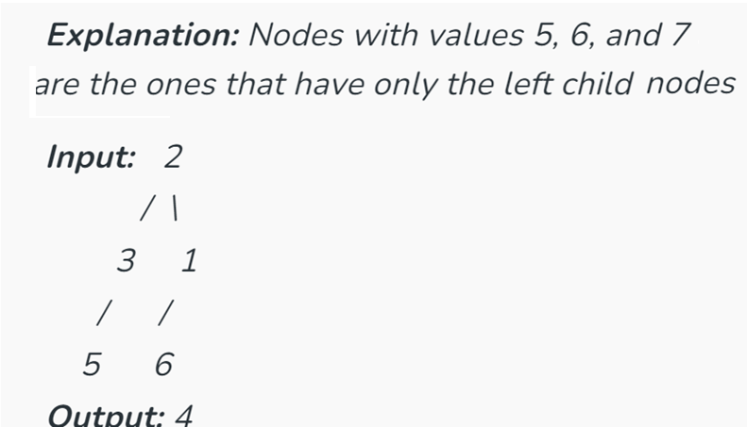
Sum of nodes in a binary tree having only the left child nodes

Slide 66
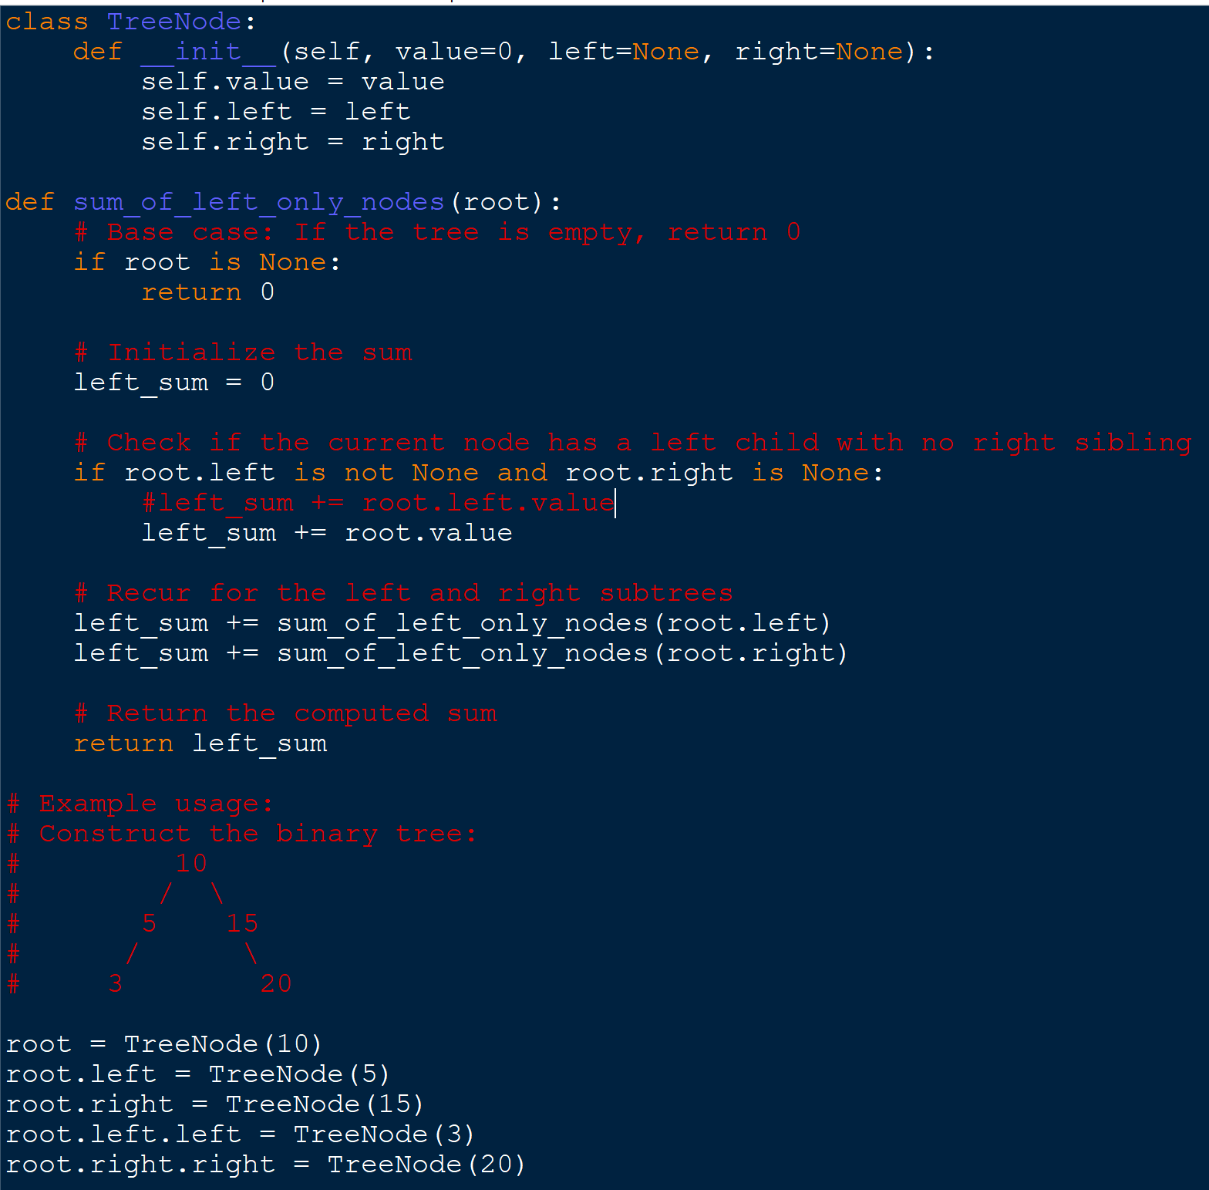
Pseudocode:
FUNCTION SumLefnod(root):
IF root IS None THEN
RETURN 0
END IF
SET left_sum TO 0
IF root.left IS NOT None AND root.right IS None THEN
SET left_sum TO left_sum + root.value
END IF
SET left_sum TO left_sum + SumLefnod(root.left)
SET left_sum TO left_sum + SumLefnod(root.right)
RETURN left_sum
END FUNCTION

Slide 67
Unit V [Graph algorithms]

Slide 68
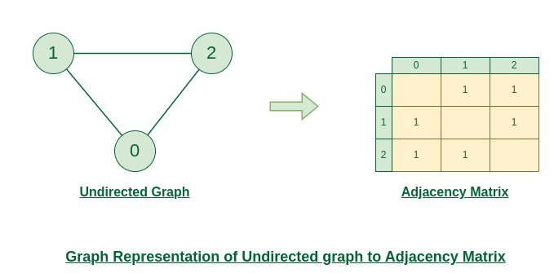
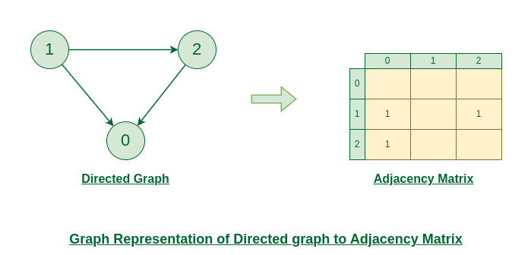
Graph and its representations
More formally a Graph is composed of a set of vertices( V ) and a set of edges( E ). The graph is denoted by G(V, E).
Represent:
Adjacency Matrix : An adjacency matrix is a way of representing a graph as a matrix of boolean (0’s and 1’s)
Adjacency List: An array of Lists is used to store edges between two vertices. The size of array is equal to the number of vertices (i.e, n).

Slide 69
Breadth First Traversal for a Graph
Breadth First Search (BFS) is a fundamental graph traversal algorithm. It begins with a node, then first traverses all its adjacent. Once all adjacent are visited, then their adjacent are traversed.
BFS itself can be used to detect cycle in a directed and undirected graph, find shortest path in an unweghted graph and many more problems.

Slide 70
BFS: Steps
Graphs may contain cycles, so we may come to the same node again.
To avoid processing a node more than once, we use a boolean visited array.
Initialization: Enqueue the given source vertex into a queue and mark it as visited.
Exploration: While the queue is not empty:
Dequeue a node from the queue and visit it (e.g., print its value).
For each unvisited neighbor of the dequeued node:
Enqueue the neighbor into the queue.
Mark the neighbor as visited.
Termination: Repeat step 2 until the queue is empty.

Slide 71
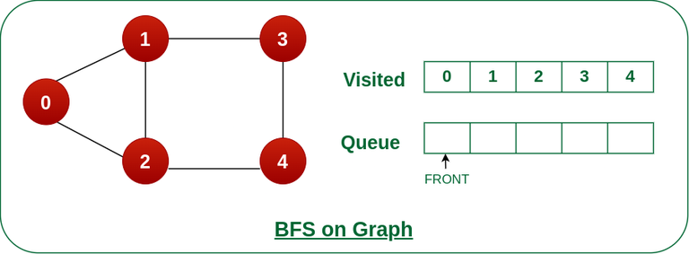

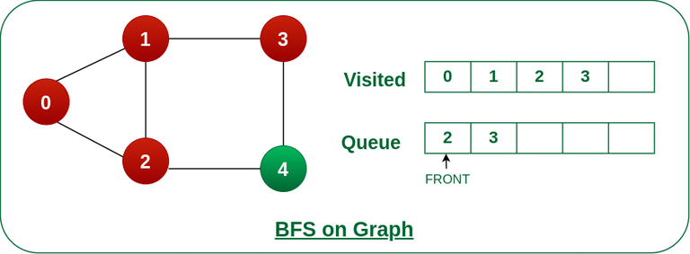
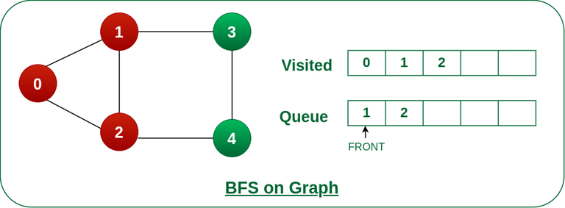

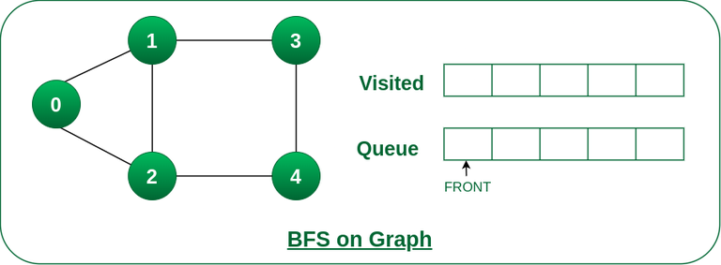
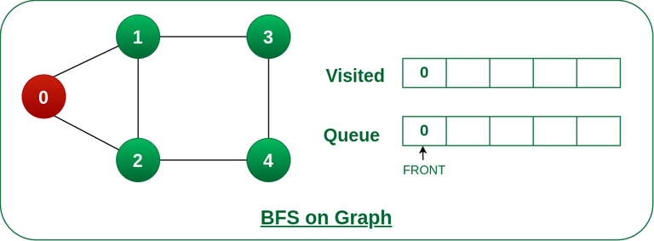

Slide 72
Online Task
https://www.geeksforgeeks.org/problems/bfs-traversal-of-graph/1?itm_source=geeksforgeeks&itm_medium=article&itm_campaign=practice_card

Slide 73
Depth First Traversal for a Graph
Depth First Traversal (or DFS) for a graph is similar to Depth First Traversal of a tree.
The only catch here is, that, unlike trees, graphs may contain cycles (a node may be visited twice).
To avoid processing a node more than once, use a boolean visited array.
A graph can have more than one DFS traversal.

Slide 74







Slide 75




Slide 76

Eulerian path and circuit
An Euler path, in a graph or multigraph, is a walk through the graph which uses every edge exactly once.
An Euler circuit is an Euler path which starts and stops at the same vertex
A multigraph is a graph that allows multiple edges to connect two vertices.
In other words, a multigraph can have more than one edge between a pair of nodes.

Slide 77
Eulerian path for an undirected graph
An undirected graph has an Eulerian path if either all vertices have an even degree, or exactly two vertices have an odd degree.
The base case of this problem is if the number of vertices with an odd number of edges(i.e. odd degree) is greater than 2 then there is no Eulerian path.
If it has the solution and all the nodes have an even number of edges then we can start our path from any of the nodes.
If it has the solution and exactly two vertices have an odd number of edges then we have to start our path from one of these two vertices.
There will not be the case where exactly one vertex has an odd number of edges, as there is an even number of edges in total.

Slide 78

The process to Find the Path:
First, take an empty stack and an empty path.
If all the vertices have an even number of edges then start from any of them.
If two of the vertices have an odd number of edges then start from one of them.
Set variable current to this starting vertex.
Repeat process 4 and 5 until the stack is empty
If the current vertex has at least one adjacent node then first discover that node and then discover the current node by backtracking.
To do so add the current node to stack,
Remove the edge between the current node and neighbor node,
Set current to the neighbor node.
If the current node has not any neighbor then add it to the path and pop stack set current to popped vertex.
[Repeat process 3 and 4 until the stack is empty and the current node has not any neighbor.]
https://www.geeksforgeeks.org/eulerian-path-undirected-graph/

Slide 79
Eulerian Path for an Undirected Graph
An Eulerian Path is a trail in a graph that visits every edge exactly once.
A graph can have multiple Eulerian paths, but each path must start and end at different vertices if the graph is not an Eulerian circuit.
Conditions
For a connected undirected graph to contain an Eulerian Path:
Exactly two vertices must have an odd degree (i.e., they must have an odd number of edges).
All other vertices must have an even degree

Slide 80

Key Points
The path starts at one odd-degree vertex and ends at the other.
If the graph contains more than two odd-degree vertices, no Eulerian Path exists.

Slide 81
Eulerian Circuit for an Undirected Graph
Definition
An Eulerian Circuit is a trail in a graph that visits every edge exactly once and returns to the starting vertex, forming a cycle.
Conditions
For a connected undirected graph to contain an Eulerian Circuit:
All vertices must have an even degree.
The graph must be connected.

Slide 82

Key Points
An Eulerian Circuit is a special case of the Eulerian Path where the start and end vertices are the same.
If even one vertex has an odd degree, an Eulerian Circuit does not exist.

Slide 83

Hamiltonian Path in an Undirected Graph
A Hamiltonian Path is a path in a graph that visits each vertex exactly once, but it does not need to traverse every edge.
A Hamiltonian Path may or may not form a cycle.
Conditions
There is no necessary or sufficient condition to check for the existence of a Hamiltonian Path in a general undirected graph. However, some useful properties:
Dirac's Theorem: If a graph has n vertices (with n≥3) and every vertex has a degree of at least n/2, the graph has a Hamiltonian path.

Slide 84


Slide 85


Slide 86


Slide 87



Slide 88
Unit VI [Problems and algorithms based on Graphs]

Slide 89
6.1 Distance of nearest cell having 1
The "Distance of Nearest Cell Having 1" problem is a grid-based problem where you are given a matrix (2D grid) consisting of 0s and 1s.
The task is to find the shortest distance from every cell containing 0 to the nearest cell containing 1.
If a cell already contains 1, its distance is 0.
This is a common problem for practicing graph traversal techniques like Breadth-First Search (BFS) because it involves finding the shortest path in an unweighted grid.

Slide 90

6.2 Dijkstra’s shortest path algorithm

Slide 91


Slide 92


Slide 93

Distance
D[] | v1 | v 2 | v3 | v4 | v5
v1 | ∞ | ∞ | ∞ | ∞ | ∞
v 2 | ∞ | ∞ | ∞ | ∞ | ∞
v3 | ∞ | ∞ | ∞ | ∞ | ∞
v4 | ∞ | ∞ | ∞ | ∞ | ∞
v5 | ∞ | ∞ | ∞ | ∞ | ∞
Parent
P[] | v1 | v 2 | v3 | v4 | v5
v1
v 2
v3
v4
v5
Q = | v1 | v 2 | v3 | v4 | v5
s=v1
Distance
D[] | v1 | v 2 | v3 | v4 | v5
v1 | ∞ | 10 | 3 | ∞ | ∞
v 2 | ∞ | ∞ | ∞ | ∞ | ∞
v3 | ∞ | ∞ | ∞ | ∞ | ∞
v4 | ∞ | ∞ | ∞ | ∞ | ∞
v5 | ∞ | ∞ | ∞ | ∞ | ∞
Parent
P[] | v1 | v 2 | v3 | v4 | v5
v1 |  | v1 | v1
v 2
v3
v4
v5
Q = | v1 | v 2 | v3 | v4 | v5
s=v1

Slide 94

6.3 Bellman Ford algorithm

Slide 95


6.4 Minimum Spanning Tree algorithms namely Prim’s algorithm

Slide 96

6.5 Kruskal algorithm

Slide 97
6.6 Graph colouring problem
The graph colouring problem involves assigning colours to the vertices of a graph such that no two adjacent vertices have the same colour. The goal is to minimize the number of colours used.
Types:
Vertex Colouring: Colouring vertices such that no adjacent vertices share the same colour.
Edge Colouring: Colouring edges such that no two edges sharing a vertex have the same colour.
Greedy Algorithm for Graph Colouring (Vertex):
Sort vertices.
Assign the smallest possible colour to each vertex that isn’t assigned to its adjacent vertices.

Slide 98


Slide 99

6.7 Check if graph is bipartite
A graph is bipartite if it is possible to divide the set of vertices into two sets such that no two vertices within the same set are adjacent.
Approach: A graph is bipartite if it can be 2-coloured, which can be done by performing a BFS/DFS and attempting to alternate the colour of neighbouring vertices.

Slide 100


6.8 Detect cycle in graph
A cycle exists in a graph if we can return to a starting node after traversing some edges without retracing any edge.
For Directed Graphs: We can use DFS and track the nodes in the current recursion stack to detect back edges.
For Undirected Graphs: A cycle is detected if we visit a node that is already visited and not the parent.

Slide 101

6.9 Check if cycle exists between two nodes
To check if a cycle exists between two nodes, you can run DFS from one node to another and track visited nodes. If the target node can reach the source node during the traversal, a cycle exists.

Slide 102
6.10 Strongly Connected Components
In a directed graph, a strongly connected component (SCC) is a maximal subgraph in which every vertex is reachable from every other vertex in the component.
Approach:
Kosaraju’s Algorithm: Two-pass DFS to find all SCCs.
Perform DFS to order vertices by finish time.
Reverse the graph and perform DFS again using the order from the first pass.

Slide 103
Strongly Connected Components …contd…
def kosaraju(graph):
def dfs(v, visited, stack):
visited[v] = True
for u in graph[v]:
if not visited[u]:
dfs(u, visited, stack)
stack.append(v)
def reverse_graph(graph):
rev_graph = {v: [] for v in graph}
for v in graph:
for u in graph[v]:
rev_graph[u].append(v)
return rev_graph
visited = {v: False for v in graph}
stack = []
# First DFS pass
for v in graph:
if not visited[v]:
dfs(v, visited, stack)
rev_graph = reverse_graph(graph)
visited = {v: False for v in graph}
sccs = []
# Second DFS pass (on reversed graph)
while stack:
v = stack.pop()
if not visited[v]:
scc = []
dfs(v, visited, scc)
sccs.append(scc)
return sccs

Slide 104

6.11 Shortest path from 1 to n
To find the shortest path from node 1 to n in an unweighted graph, use BFS. For weighted graphs, Dijkstra’s algorithm is more appropriate.

Slide 105
6.12 Minimum product spanning tree
In this problem, the objective is to construct a spanning tree with the minimum product of edge weights rather than the sum. This can be modified from Kruskal’s or Prim’s algorithm by minimizing the logarithm of the product of the edge weights.
Convert to Logarithmic Space: Replace each edge weight w with log(w).
Apply Kruskal’s or Prim’s algorithm to find the MST based on the new logarithmic weights.
Steps:
Convert edge weights using logarithms.
Apply Kruskal’s or Prim’s algorithm.

